Slide 1
Georgia’s
Geographic
Regions
SS8G1b
© 2015 Brain Wrinkles

Slide 2
Five Regions
Georgia is a geographically diverse state that is divided into five regions.
The first three regions (Appalachian Plateau, Valley and Ridge, and Blue Ridge) are in the mountains and foothills of the state and form part of the Appalachian Mountain range.
The other two (Piedmont and Coastal Plain) include coastal and farming areas, as well as some of the large cities in the middle of the state.
© 2015 Brain Wrinkles

Slide 3
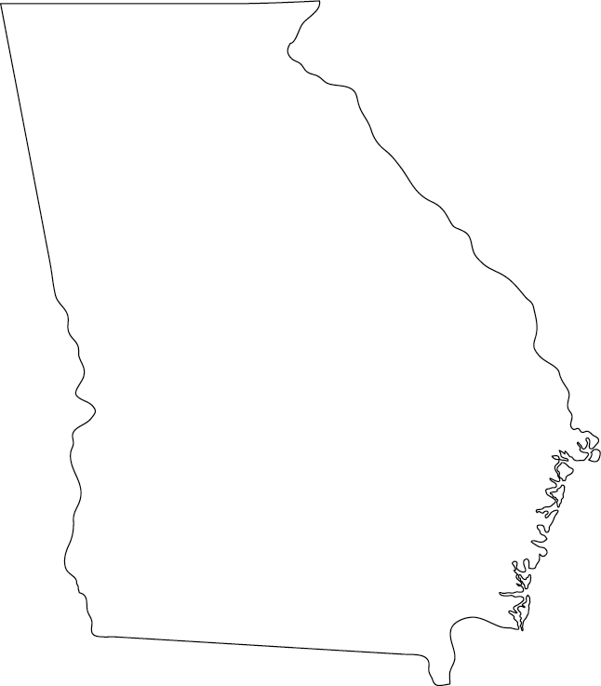
Appalachian Plateau
Blue
Ridge
Valley &
Ridge
Piedmont
Coastal
Plain
© 2015 Brain Wrinkles

Slide 4
Appalachian Plateau
The Appalachian Plateau is the state’s smallest region.
It’s located in the very northwest corner of Georgia and encompasses Dade County.
The region features a long, narrow valley with Sand Mountain on one side and Lookout Mountain on the other.
© 2015 Brain Wrinkles

Slide 5
Appalachian Plateau
© 2015 Brain Wrinkles

Slide 6
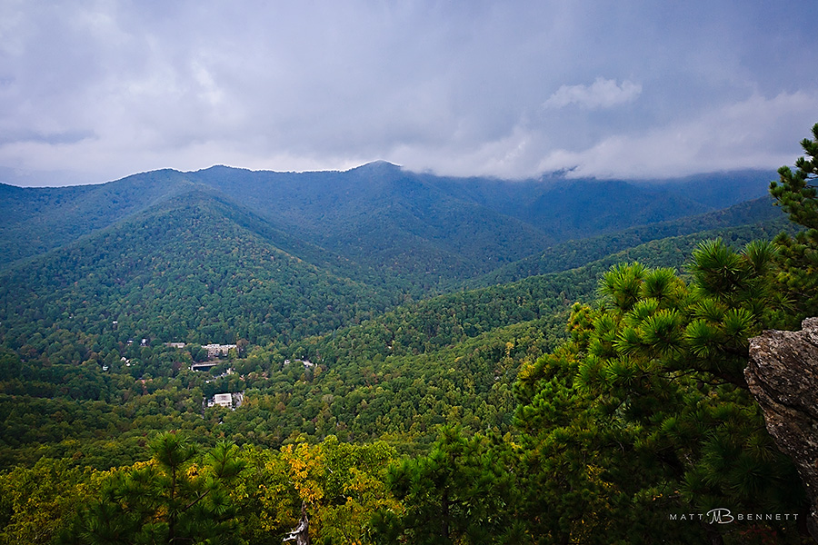
View from Lookout Mountain
© 2015 Brain Wrinkles

Slide 7
Appalachian Plateau
The region contains two waterfalls, many underground caves, and it is covered in forests.
The average summer temperature is 70 degrees, and the average winter temperature is just above 40 degrees.
It is not a good area for farming because of the sandy soil; however, it was once a profitable area for mining coal and iron ore.
© 2015 Brain Wrinkles

Slide 8
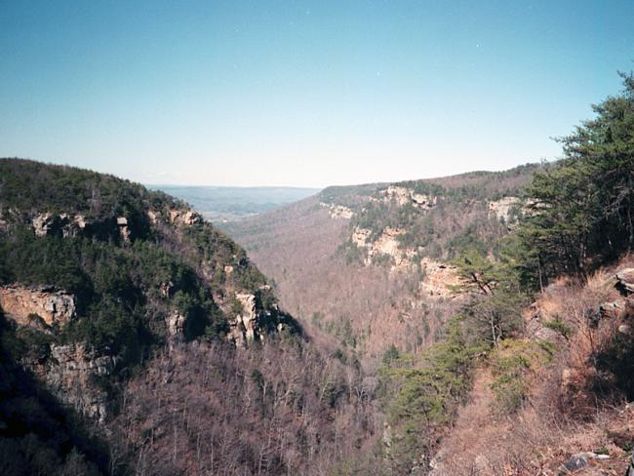
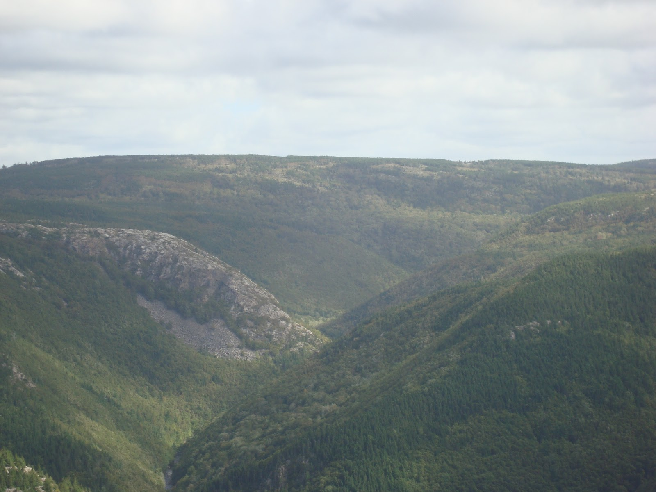
© 2015 Brain Wrinkles

Slide 9
Blue Ridge
The Blue Ridge region is in the northeast corner of Georgia, and it is made up of the Blue Ridge Mountains.
This area contains the southern point of the Appalachian Mountains (which run up to Maine).
The region is also home to Georgia’s highest peak, Brasstown Bald (4,784 feet).
© 2015 Brain Wrinkles

Slide 10
Blue
Ridge
© 2015 Brain Wrinkles

Slide 11
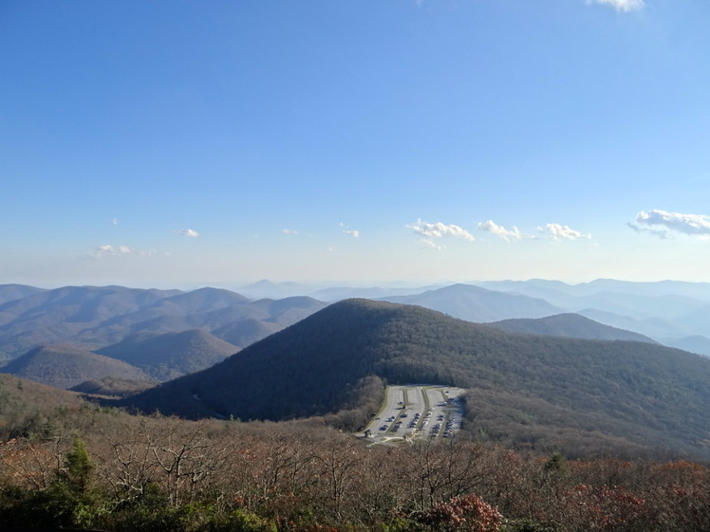
Brasstown Bald
© 2015 Brain Wrinkles

Slide 12
Blue Ridge
The tallest waterfall east of the Mississippi River, Amicalola Falls, is in this region.
Also, Tallulah Gorge, which is two miles long and 1,000 feet deep, is located here.
The area attracts thousands of tourists each year due to its beautiful scenery and outdoor activities.
Aside from apples, grapes, and some vegetables, not much agriculture is grown here.
© 2015 Brain Wrinkles

Slide 13
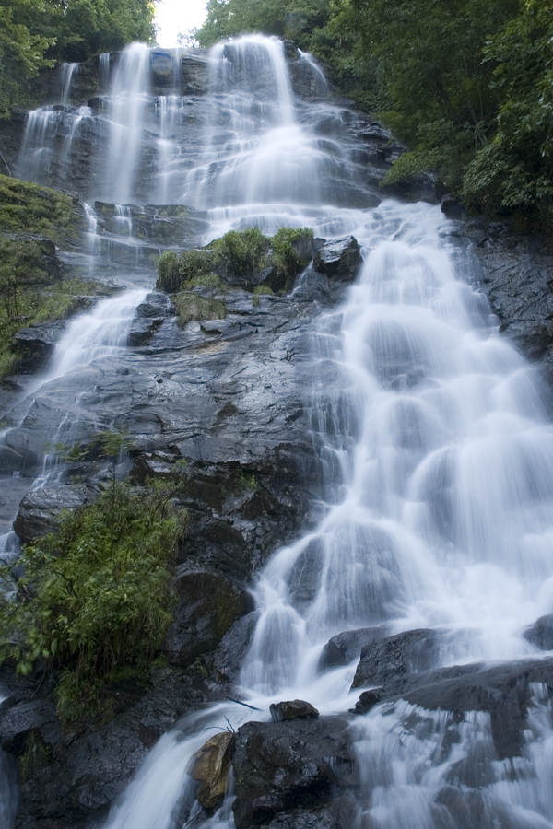
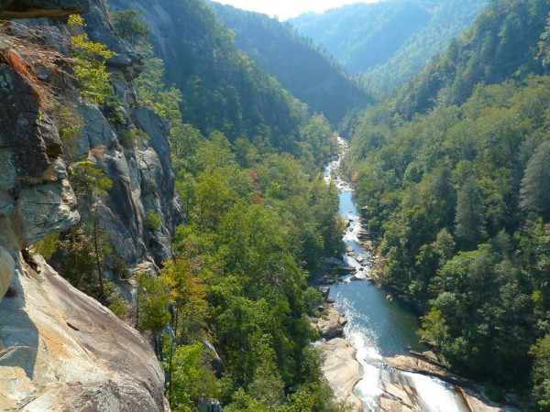
Amicalola Falls
Tallulah Gorge
© 2015 Brain Wrinkles

Slide 14
Blue Ridge
The Blue Ridge region receives the most rainfall in Georgia.
The average summer temperature is 69 degrees, while the average winter temperature is 45 degrees.
© 2015 Brain Wrinkles

Slide 15
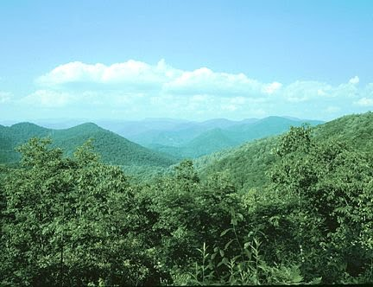
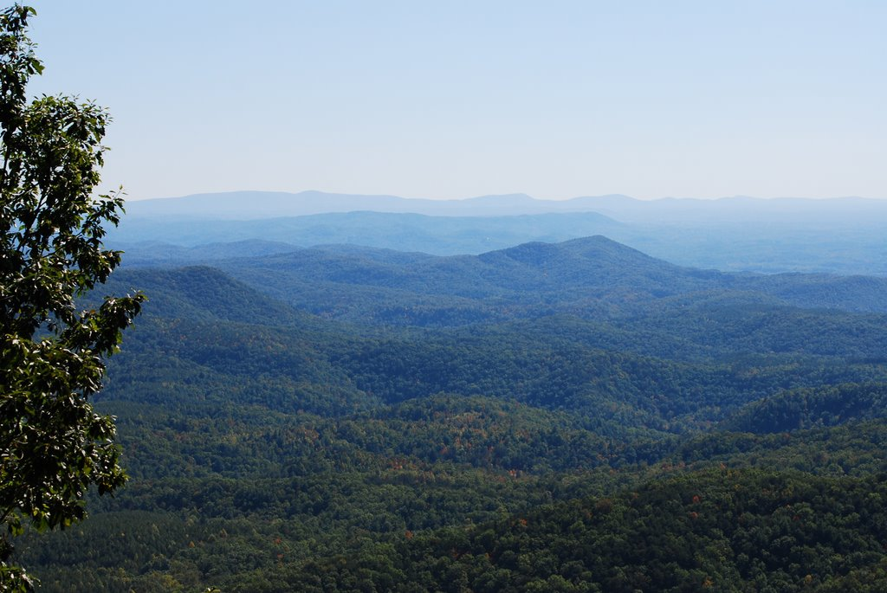
© 2015 Brain Wrinkles

Slide 16
Valley & Ridge
The Valley and Ridge region is located in northwest Georgia, east of the Appalachian Plateau.
The region consists of several high, narrow mountain ridges and the valleys between them.
The elevation of the region ranges from 700 to 1,600 feet.
The region’s climate is similar to the Blue Ridge region, with slightly less rainfall.
© 2015 Brain Wrinkles

Slide 17
Valley &
Ridge
© 2015 Brain Wrinkles

Slide 18
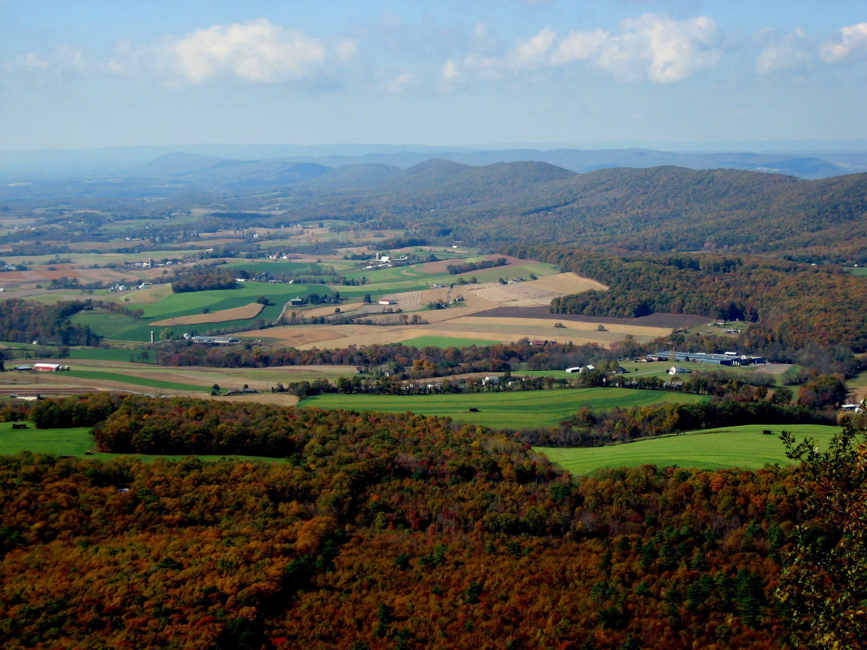
© 2015 Brain Wrinkles

Slide 19
Valley & Ridge
Mining and farming are the region’s main industries.
The soil is rich and agricultural products include corn, soybeans, wheat, cotton, and apples.
Beef cattle are raised on pastures in the valleys.
© 2015 Brain Wrinkles

Slide 20
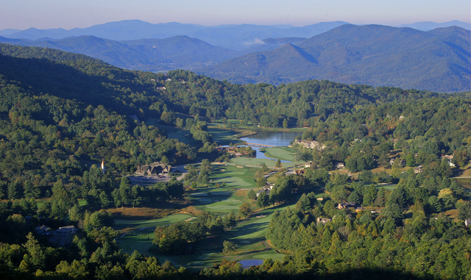
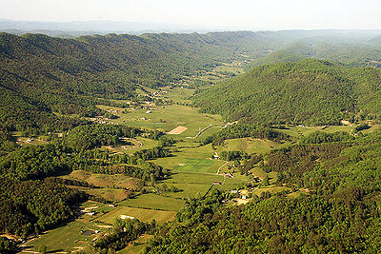
© 2015 Brain Wrinkles

Slide 21
Piedmont
The Piedmont region is in the central area of Georgia, and makes up roughly 30% of the state’s land area.
The name means “foot of the mountains”, as it is made up of low rolling hills that slope towards the south.
The elevation ranges from 500 feet at its southern border (called the Fall Line) to 1700 feet at its northern border.
© 2015 Brain Wrinkles

Slide 22
Piedmont
© 2015 Brain Wrinkles

Slide 23
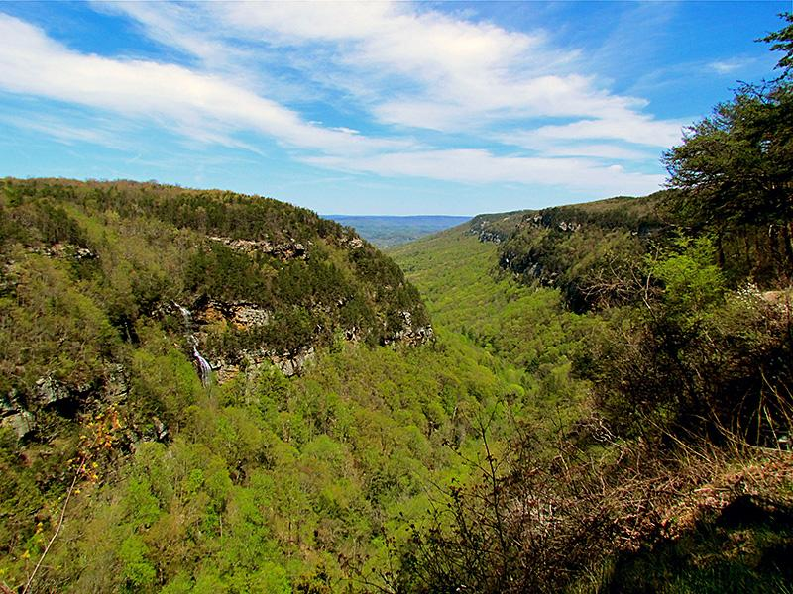
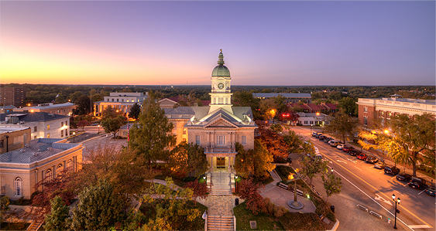
Athens, GA
© 2015 Brain Wrinkles

Slide 24
Piedmont
The Piedmont region has large amounts of granite and marble, enabling Georgia to be the nation’s leading producer of both.
It is also known for its red clay, which is rich in iron minerals.
The region is important for agriculture, with large amounts of corn, peaches, wheat, soybeans, cattle, and poultry being produced.
© 2015 Brain Wrinkles

Slide 25
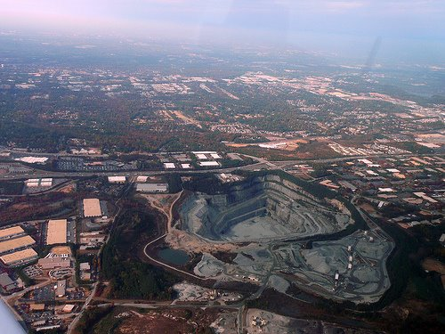
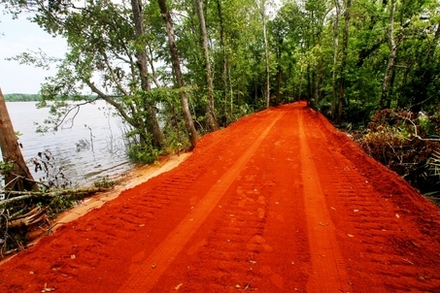
Georgia’s
Red Clay
Granite Quarry in Georgia
© 2015 Brain Wrinkles

Slide 26
Piedmont
Nearly 50% of Georgia’s population lives in this region, thanks to cities like Atlanta, Athens, Macon, Columbus, Augusta, and Milledgeville.
There are a lot of businesses in this region, and it features the bulk of Georgia’s industry.
© 2015 Brain Wrinkles

Slide 27
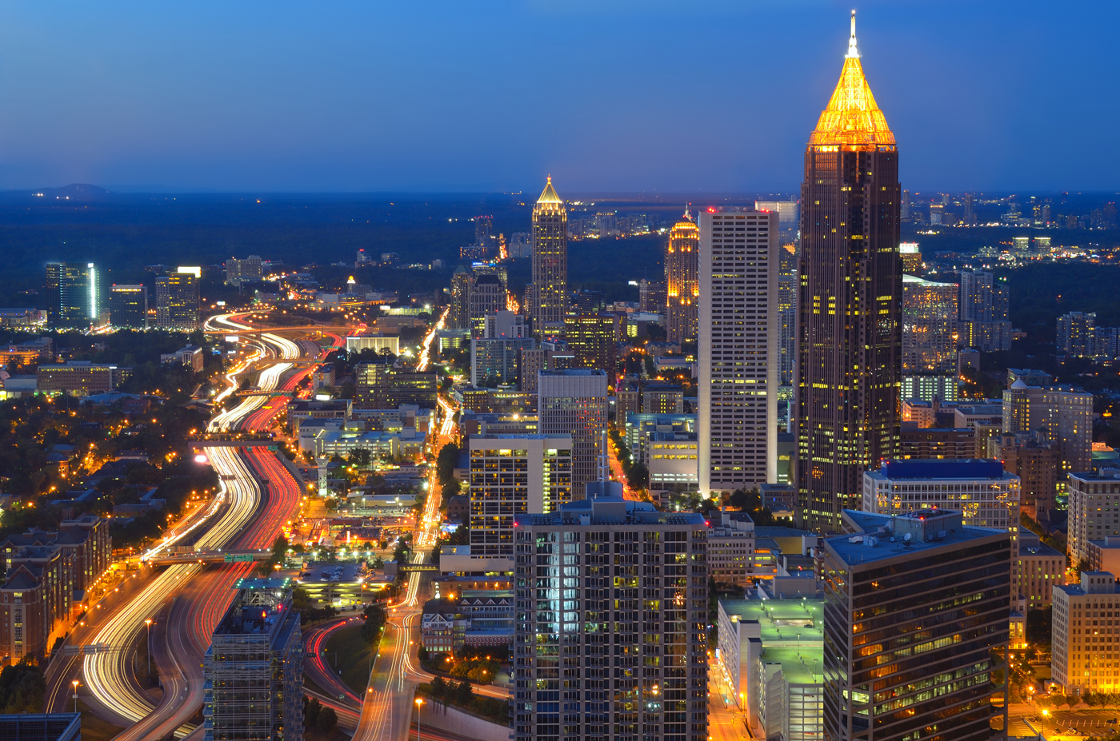
Atlanta
© 2015 Brain Wrinkles

Slide 28
Coastal Plain
The Coastal Plain is the largest region, covering roughly 60% of the state.
It begins at the Fall Line and extends to Georgia’s southern border with Florida.
It stretches from the barrier islands off of Georgia’s eastern coast to Alabama.
© 2015 Brain Wrinkles

Slide 29
Coastal
Plain
© 2015 Brain Wrinkles

Slide 30
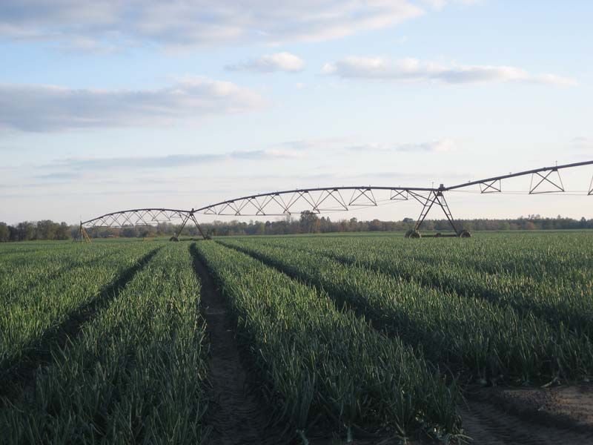
Vidalia
Onions
© 2015 Brain Wrinkles

Slide 31
Coastal Plain
The Coastal Plain has good farmland and produces the majority of the state’s crops.
Peanuts, onions, pecans, corn, and other agricultural products are grown here.
The region has 100 miles of coast, which attracts large numbers of tourists each year.
© 2015 Brain Wrinkles

Slide 32
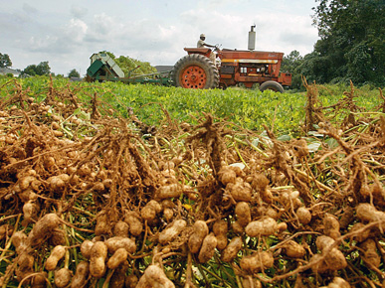
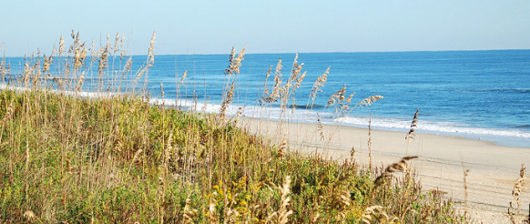
© 2015 Brain Wrinkles

Slide 33
Coastal Plain
The Coastal Plain and Piedmont regions are more humid and tropical than the other regions because they are between the warm waters of the Gulf of Mexico and the Atlantic Ocean.
Summer tends to be long and hot, while the winter is mild compared to the rest of the country.
© 2015 Brain Wrinkles

