Slide 1
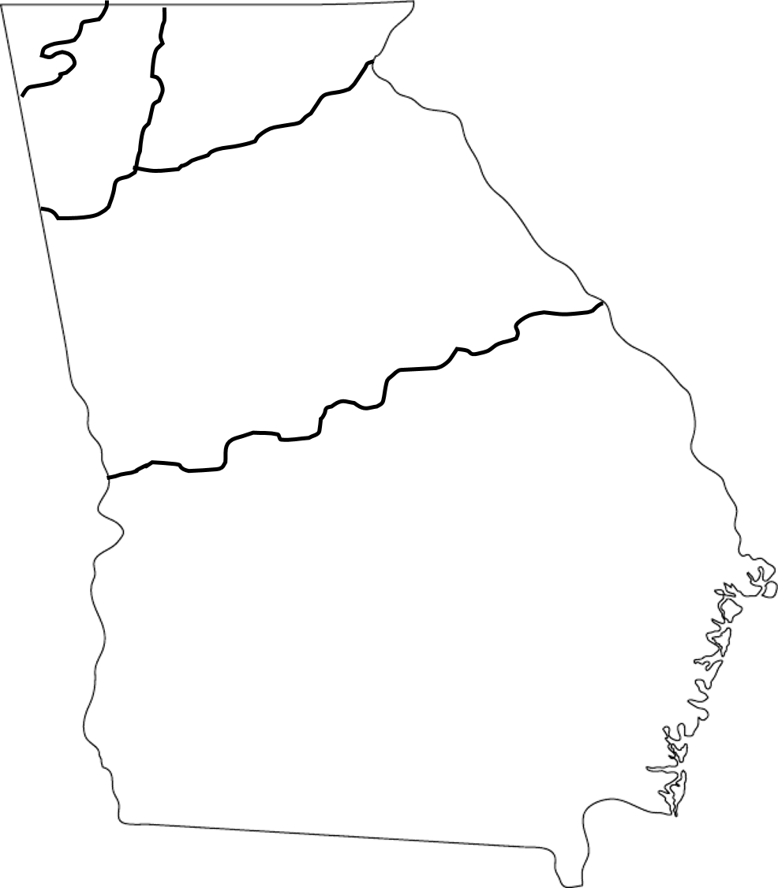
© 2015 Brain Wrinkles
Georgia’s 5 Regions
Directions: Label the following regions on the map. Please use different colors for each region.

