Slide 1
Georgia’s
Physical
Features
SS8G1c
© 2015 Brain Wrinkles

Slide 2
Physical Features
There are many different physical features in the Georgia.
Physical features include bodies of water, deserts, mountain ranges, and other landforms.
They are created by nature; they are not man-made.
© 2015 Brain Wrinkles

Slide 3
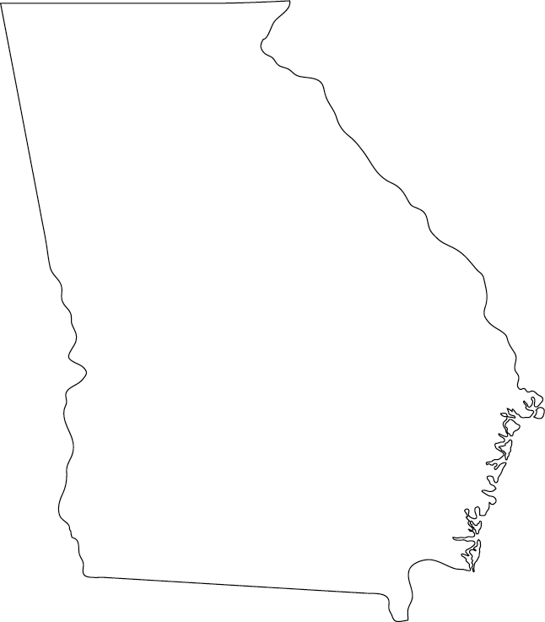
Appalachian
Mountains
Chattahoochee
River
Fall
Line
Savannah
River
Barrier Islands
Okefenokee
Swamp
© 2015 Brain Wrinkles

Slide 4
Fall Line
The Fall Line is about twenty miles wide and separates the Piedmont region from the Coastal Plain region.
It marks the part of the state where the elevation begins to drastically drop towards sea level.
This causes water to run down hill at an increased rate.
© 2015 Brain Wrinkles

Slide 5
Fall
Line
© 2015 Brain Wrinkles

Slide 6
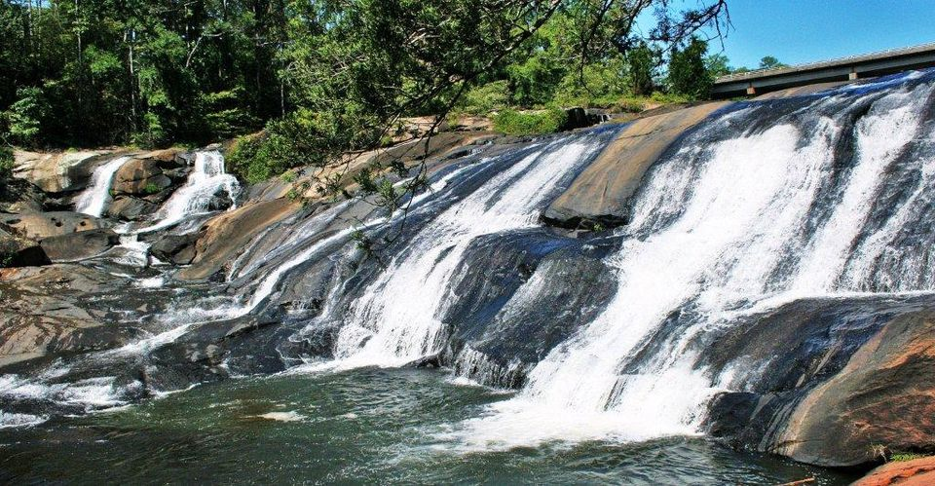
© 2015 Brain Wrinkles

Slide 7
Fall Line
In the state’s early days, Georgians built cities like Columbus, Macon, Milledgeville, and Augusta along the Fall Line rivers.
These cities began as places where goods were transferred from boats to wagons and trains.
Today, the Fall Line features some of the state’s most beautiful waterfalls.
© 2015 Brain Wrinkles

Slide 8
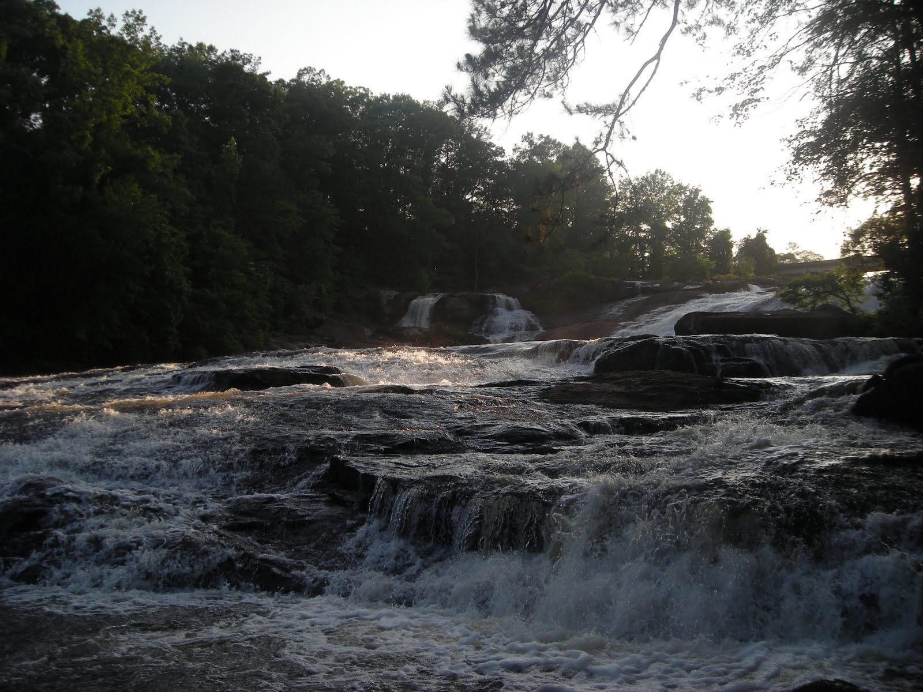
© 2015 Brain Wrinkles

Slide 9
Okefenokee Swamp
The Okefenokee Swamp is located in the southeast corner of Georgia, and it is one of the largest fresh water swamps in North America.
It covers roughly 700 square miles of the Coastal Plains region.
Its name comes from a Seminole word meaning, “land of the trembling earth”.
© 2015 Brain Wrinkles

Slide 10
Okefenokee
Swamp
© 2015 Brain Wrinkles

Slide 11
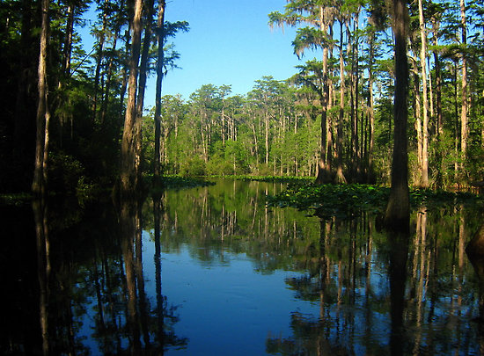
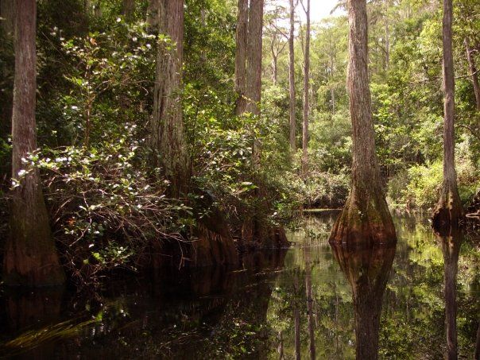
© 2015 Brain Wrinkles

Slide 12
Okefenokee Swamp
Water in the swamp averages between 2 and 4 feet deep, and there is unstable, marshy ground beneath it.
The Okefenokee Swamp is home to more than 1,000 types of plants and animals.
In 1937, President Roosevelt created the Okefenokee National Wildlife Refuge, so the swamp is now protected land.
© 2015 Brain Wrinkles

Slide 13
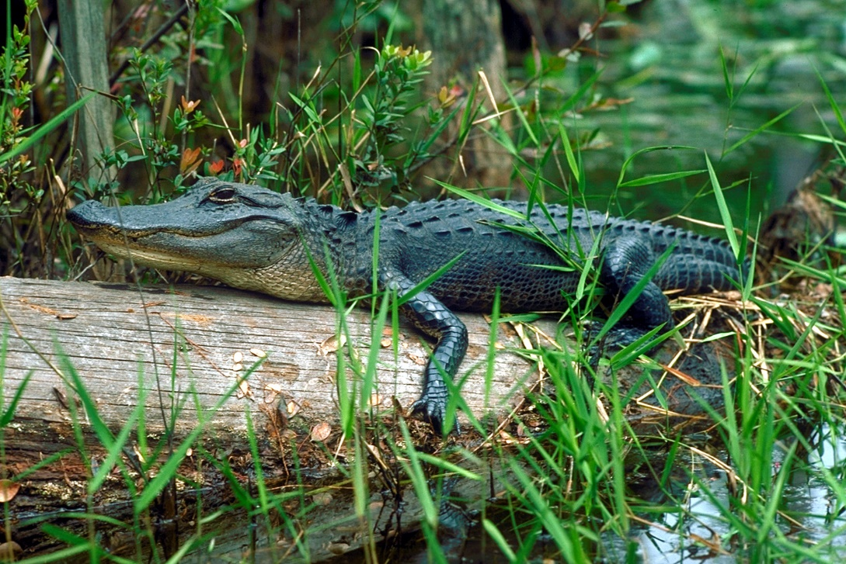
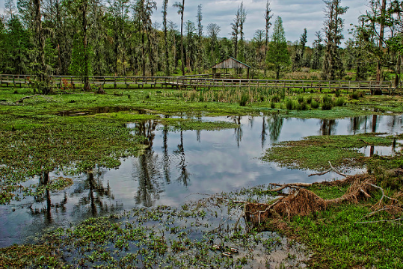
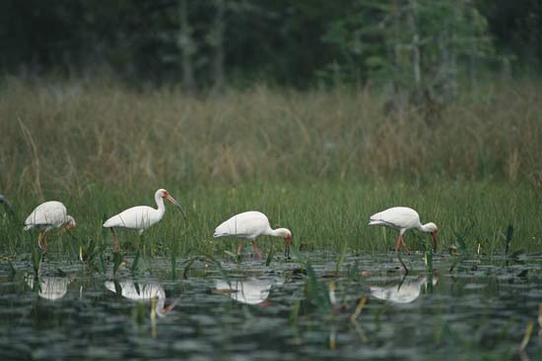
© 2015 Brain Wrinkles

Slide 14
Appalachian Mtns.
Nearly 100 miles of the Appalachian Mountain range extends into Georgia.
The southern end of the chain lies within the Blue Ridge region.
These mountains are Georgia’s highest and wettest areas, with more than 80 inches of rainfall every year.
© 2015 Brain Wrinkles

Slide 15
Appalachian
Mountains
© 2015 Brain Wrinkles

Slide 16
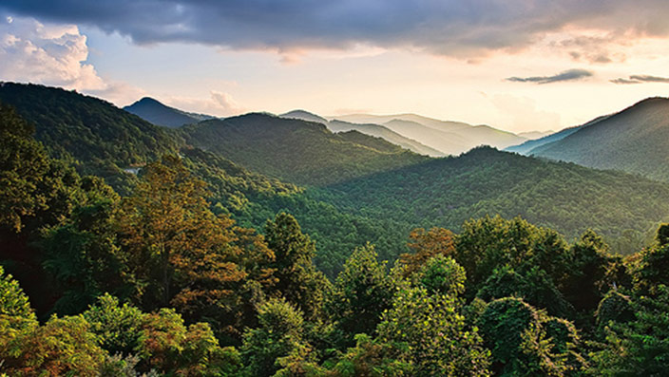
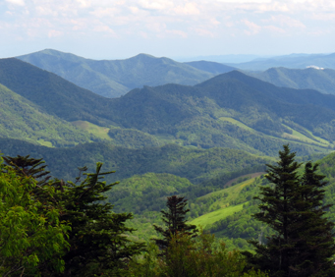
© 2015 Brain Wrinkles

Slide 17
Appalachian Mtns.
In 1828, gold was discovered in this area of the mountain range and put the town of Dahlonega on the map.
Today, tourists visit the Appalachian Mountains to enjoy the region’s beautiful views and recreational activities.
© 2015 Brain Wrinkles

Slide 18
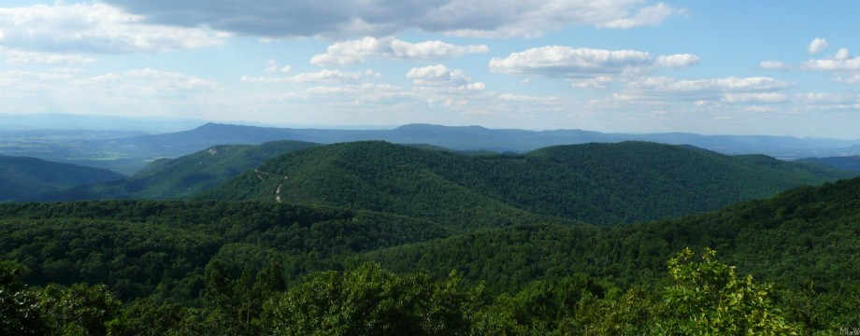
© 2015 Brain Wrinkles

Slide 19
Chattahoochee River
The Chattahoochee River begins in the Blue Ridge Mountains and flows southwest toward Alabama and the Gulf of Mexico.
The Chattahoochee is an important source of water for Georgia, as well as for Alabama and Florida.
© 2015 Brain Wrinkles

Slide 20
Chattahoochee
River
© 2015 Brain Wrinkles

Slide 21
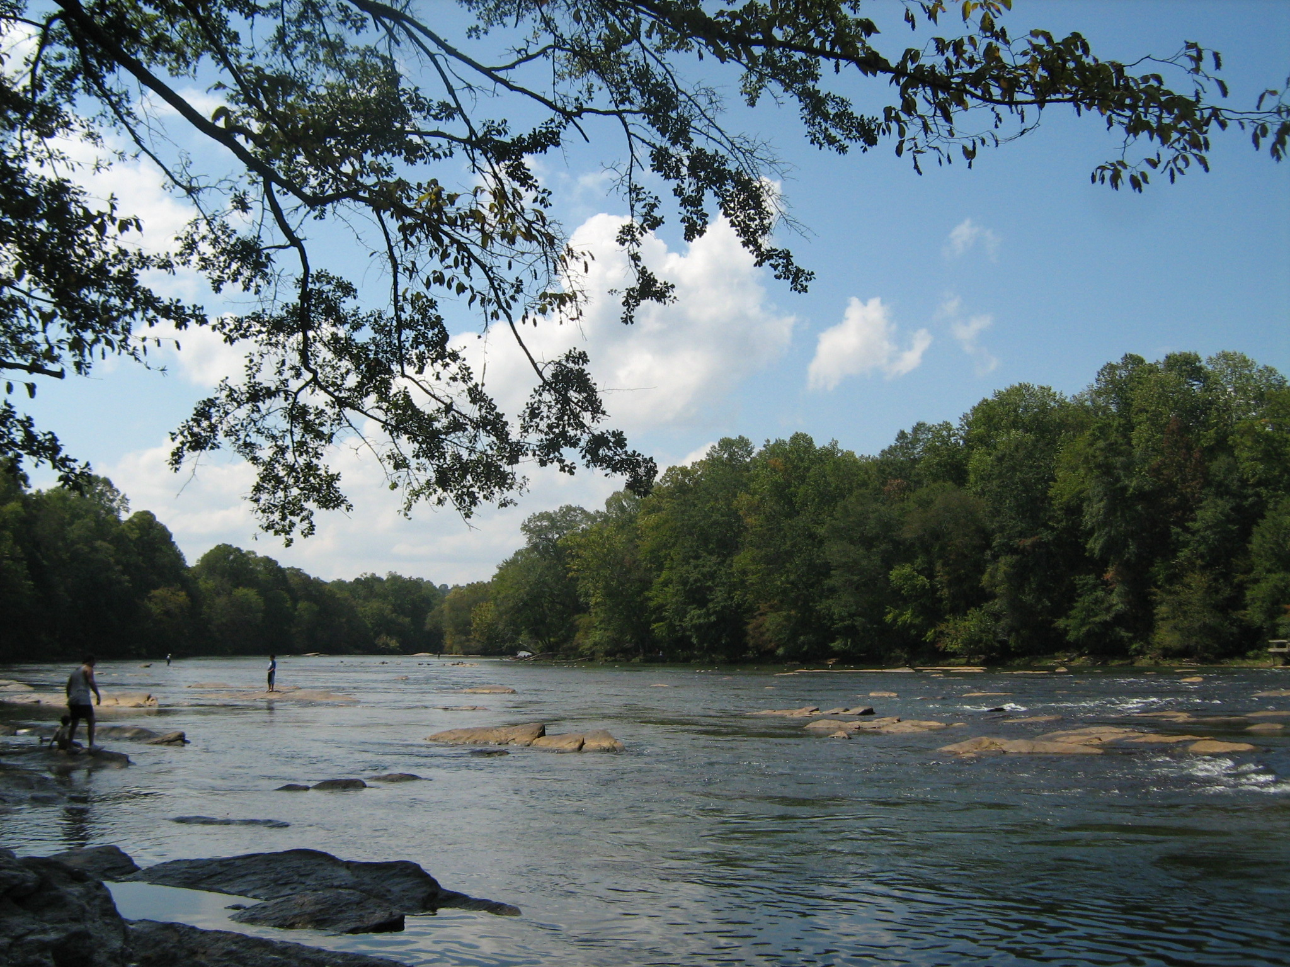
© 2015 Brain Wrinkles

Slide 22
Chattahoochee River
In the past, cities along the river used it as a source of power for mills and as a means of transportation.
Today, many man-made lakes harness water from the river for hydroelectricity, drinking water, and flood control.
It is also used for recreational activities like kayaking, canoeing, and fishing.
© 2015 Brain Wrinkles

Slide 23
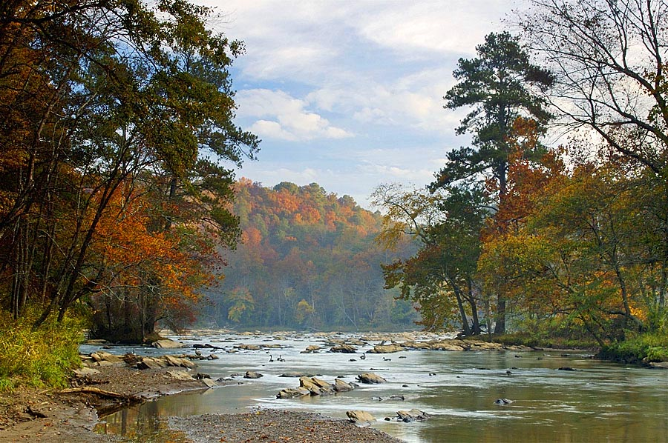
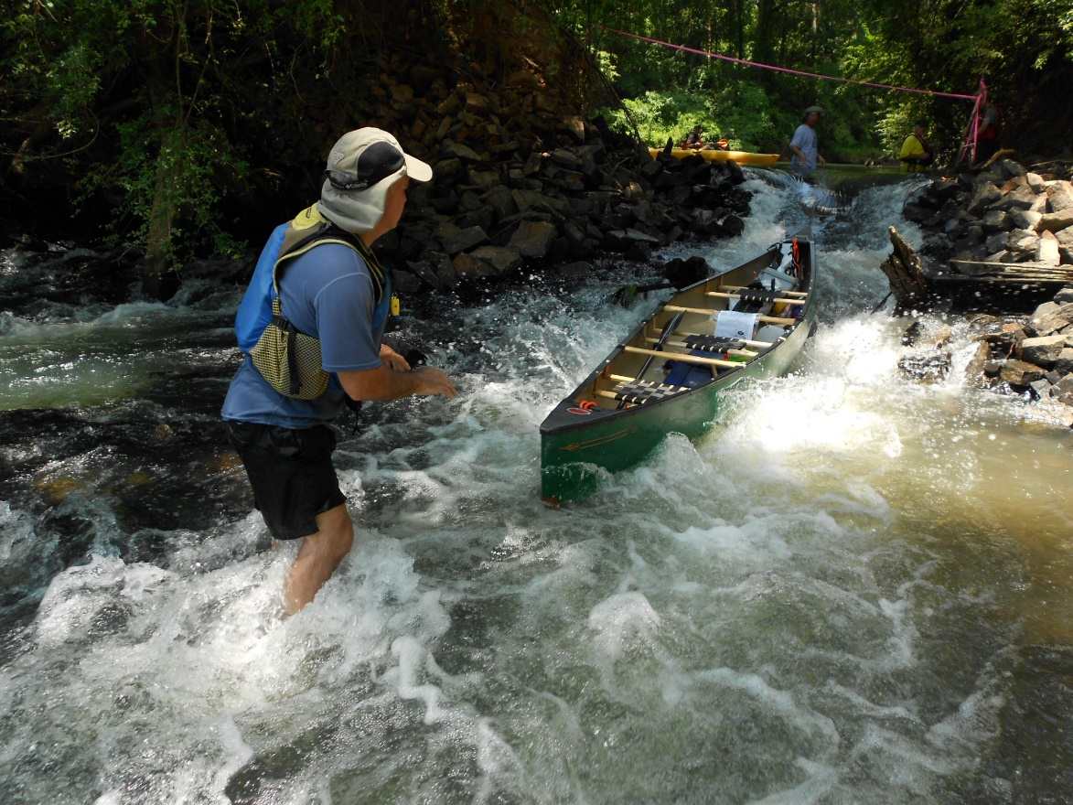
© 2015 Brain Wrinkles

Slide 24
Savannah River
The Savannah River begins in the foothills of the Appalachian Mountains and is the natural boundary between Georgia and South Carolina.
It flows southwest toward Savannah and empties into the Atlantic Ocean.
It’s important for shipping and trade because its deep waters and width make it possible for large ships to navigate.
© 2015 Brain Wrinkles

Slide 25
Savannah
River
© 2015 Brain Wrinkles

Slide 26
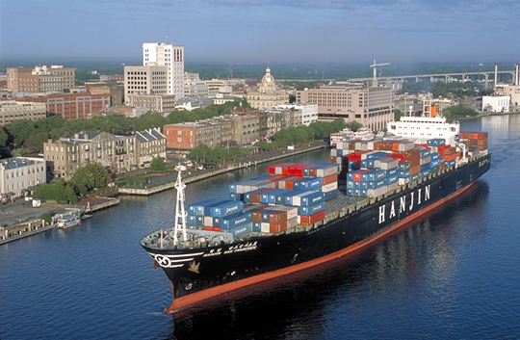
© 2015 Brain Wrinkles

Slide 27
Barrier Islands
Barrier Islands are located along Georgia’s coastline and form a barrier between the mainland and the Atlantic Ocean.
These islands protect the mainland from much of the ocean wind, waves, and currents that would otherwise erode the coast.
In Georgia’s early history, forts were built on the islands to protect the state’s coast.
© 2015 Brain Wrinkles

Slide 28
Barrier Islands
© 2015 Brain Wrinkles

Slide 29
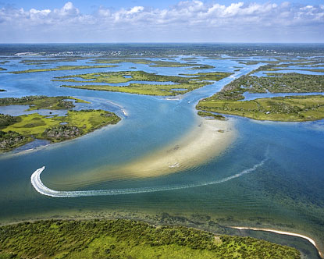
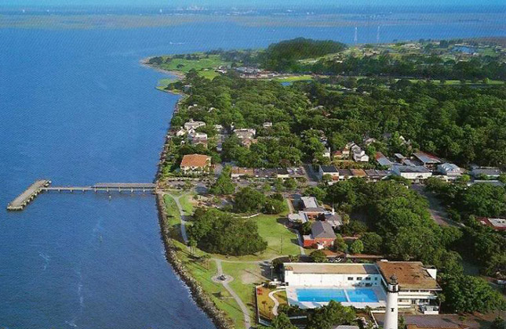
St Simons Island
© 2015 Brain Wrinkles

Slide 30
Barrier Islands
Today, some of the islands, like St Simons, Tybee, and Jekyll, are popular vacation destinations for tourists.
Other barrier islands are protected wildlife reserves and wilderness sanctuaries, and cannot be destroyed by manmade developments.
© 2015 Brain Wrinkles

Slide 31
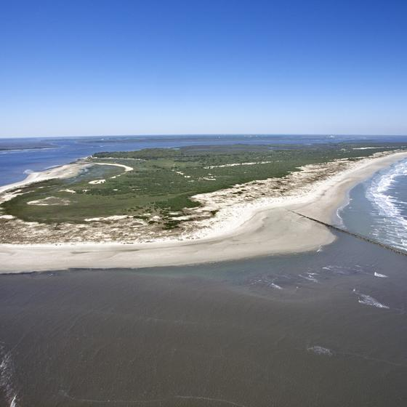
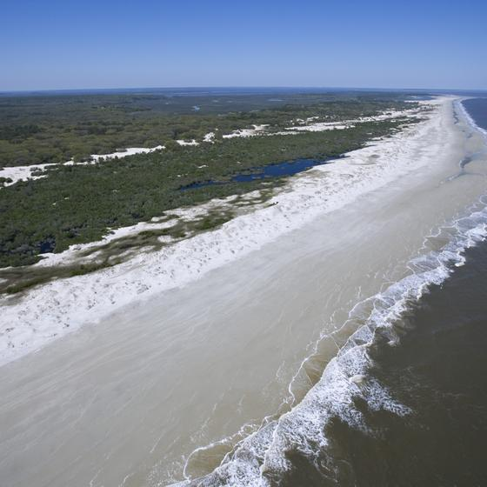
Cumberland Island
© 2015 Brain Wrinkles

Slide 32
Appalachian
Mountains
Chattahoochee
River
Fall
Line
Savannah
River
Barrier Islands
Okefenokee
Swamp
© 2015 Brain Wrinkles

