Slide 1
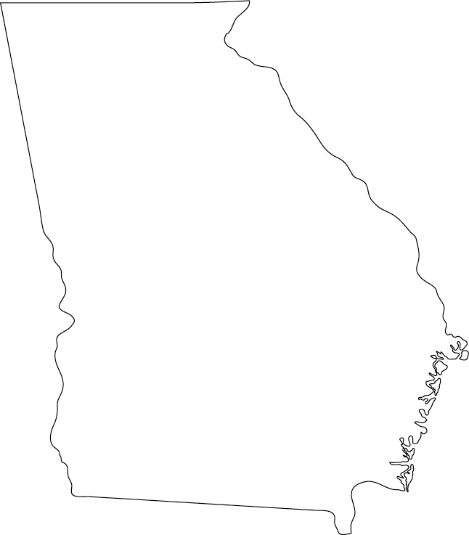
© 2015 Brain Wrinkles
Directions: Label and color each physical feature on the map: Chattahoochee River, Savannah River, Okefenokee Swamp, Appalachian Mountains, Barrier Islands, and Fall Line.
GA’s Physical Features

