Slide 1
SS8H1a
Native
Americans
Paleo, Archaic, Woodland,
& Mississippian
© 2014 Brain Wrinkles

Slide 2
Paleo Indians
The first group of people to inhabit Georgia were called Paleo Indians.
They lived in Georgia over 13,000 years ago, from 10000 to 8000 BC.
Paleo means “ancient” in Greek.
Paleo Indians were nomadic, meaning that they moved around in search of food.
They moved from place to place in groups of 25-50.
They lived in nonpermanent dwellings made in pits or shelters covered with bark and animal hides.
Paleo Indians were hunters and gatherers.
They hunted large animals like the giant bison and ate berries, nuts, and wild fruits and vegetables.
They also used tools and weapons made from stone.
Many stones that were shaped into spearheads for hunting have been found near the Savannah River, Ocmulgee River, and in the Flint River area.
Archaic Indians
The Archaic Indians lived in Georgia beginning in 8000 BC until about 1000 BC.
They built the first permanent settlements, but were also nomadic as they moved each season in search of food.
The Archaic Indians created tools and weapons out of stone and bone.
The Archaic Indians were hunters, gatherers, and fishermen.
They hunted smaller animals like deer and rabbits.
They also ate nuts and shellfish.
© 2015 Brain Wrinkles
Native American Cultures 1
KEY

Slide 3
Woodland Indians
The Woodland Indians lived in Georgia from about 1000 BC to 1000 AD.
Their lifestyle differed from previous groups because they began to plant seeds for growing crops and they created decorative, long-lasting pottery.
They also developed bows and arrows for hunting.
The Woodland Indians formed tribes, created permanent villages, and lived in dome-shaped huts.
The Woodland Indians left the first evidence of religious beliefs.
They built mounds of earth for burial sites and religious ceremonies.
These were signs that the Woodland Indians believed in an afterlife.
Mississippian Indians
The Mississippian Indians inhabited Georgia from about 800 to 1600 AD.
They lived in towns governed by chiefs, who lived in religious centers on top of large earthen mounds.
Mississippian settlements contained thousands of families.
Villages were protected by guard towers and moats.
The Mississippian Indians used stone, wood, and bone to create weapons and farming tools.
They were accomplished craftsmen, creating pottery, pipes, instruments, and jewelry.
The Mississippian Indian groups traded tools, weapons, pottery, and other goods with one another.
Mississippian Indians began farming on a large scale —they grew maize, squash, beans, tobacco, etc.
They built flat-topped burial mounds and had religious ceremonies.
The dead were buried in fine cloths with feathered headdresses and the bodies were tattooed and painted.
They were alive when Europeans discovered America, but soon after their culture began to disappear…
© 2015 Brain Wrinkles
Native American Cultures 2
KEY

Slide 4
SS8H1a
Native
Americans
Paleo, Archaic, Woodland,
& Mississippian
© 2014 Brain Wrinkles

Slide 5
Native American Cultures
10000 BC
8000 BC
1000 BC
800 AD
1600 AD
Archaic
Mississippian
Paleo
Woodland
© 2014 Brain Wrinkles

Slide 6
SS8H1a
Paleo
© 2014 Brain Wrinkles

Slide 7
Paleo Indians
The first group of people to inhabit Georgia were called Paleo Indians.
They lived in Georgia over 13,000 years ago, from 10000 to 8000 BC.
Paleo means “ancient” in Greek.
© 2014 Brain Wrinkles

Slide 8
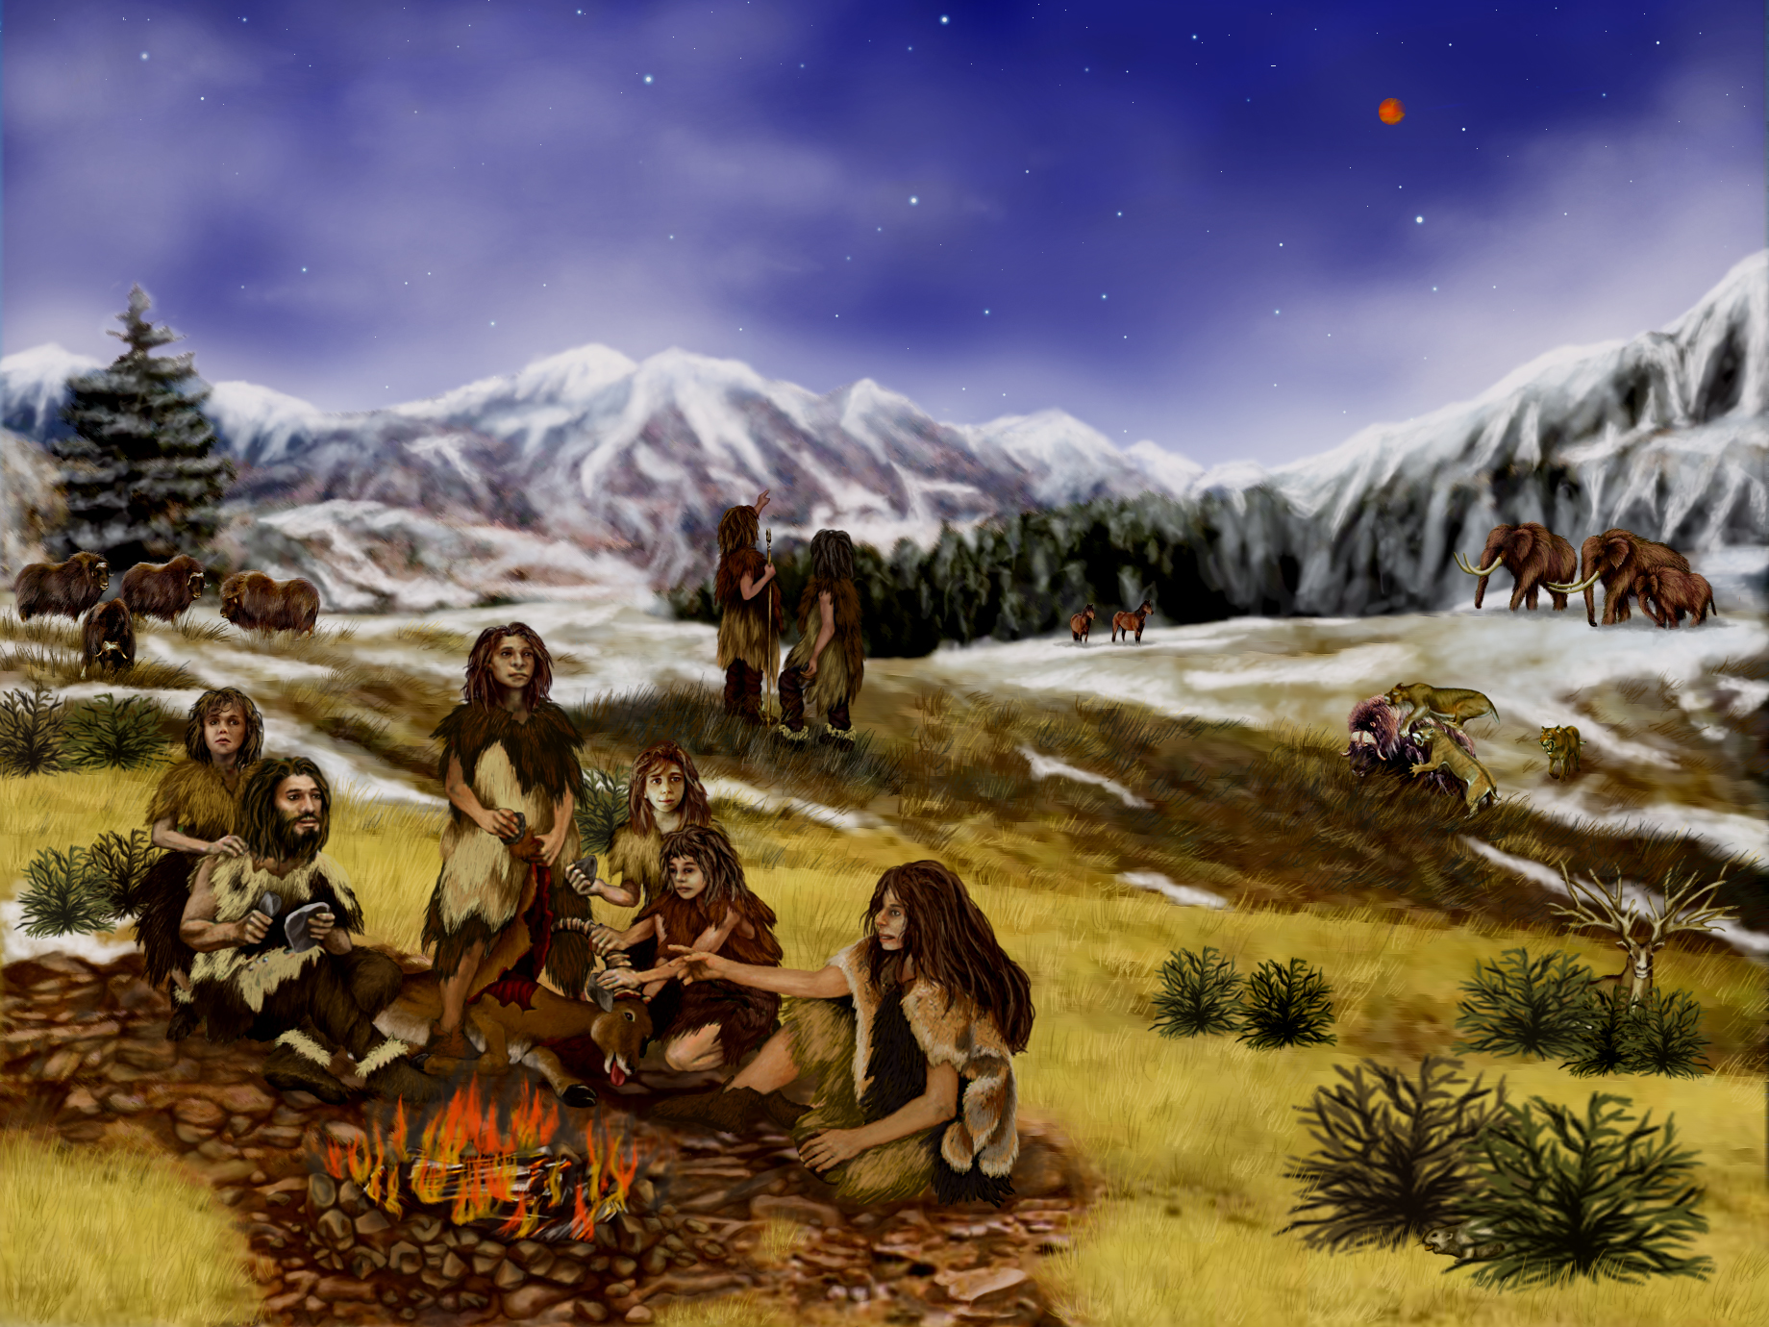
© 2014 Brain Wrinkles

Slide 9
Paleo Indians
Paleo Indians were nomadic, meaning that they moved around in search of food.
They moved from place to place in groups of 25-50.
They lived in nonpermanent dwellings made in pits or shelters covered with bark and animal hides.
© 2014 Brain Wrinkles

Slide 10
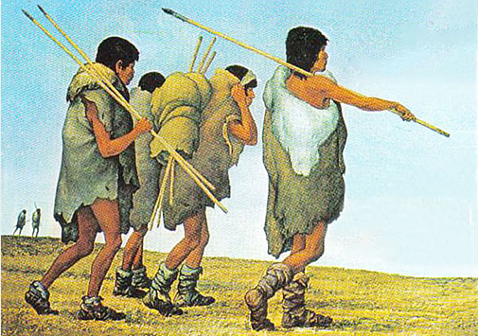
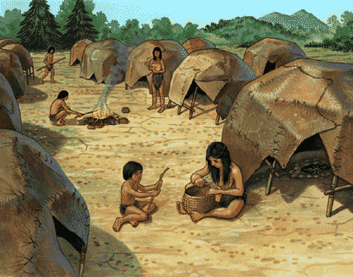
Paleo Indians
© 2014 Brain Wrinkles

Slide 11
Paleo Indians
Paleo Indians were hunters and gatherers.
They hunted large animals like the giant bison and ate berries, nuts, and wild fruits and vegetables.
They also used tools and weapons made from stone.
Many stones that were shaped into spearheads for hunting have been found near the Savannah River, Ocmulgee River, and in the Flint River area.
© 2014 Brain Wrinkles

Slide 12
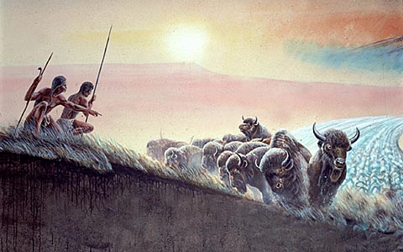
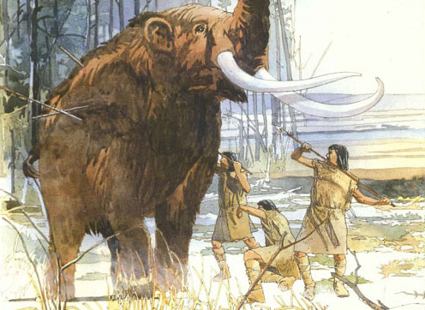
Paleo Indians
© 2014 Brain Wrinkles

Slide 13
SS8H1a
Archaic
© 2014 Brain Wrinkles

Slide 14
Archaic Indians
The Archaic Indians lived in Georgia beginning in 8000 BC until about 1000 BC.
They built the first permanent settlements, but were also nomadic as they moved each season in search of food.
The Archaic Indians created tools and weapons out of stone and bone.
© 2014 Brain Wrinkles

Slide 15
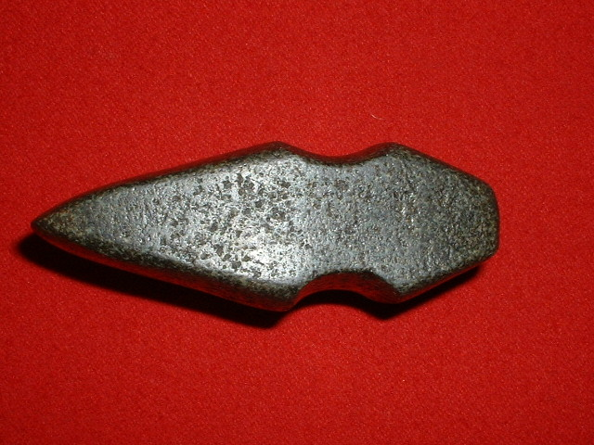
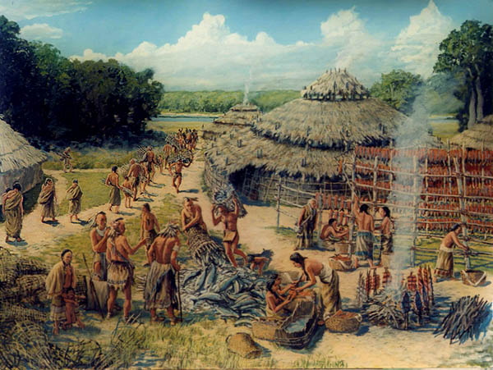
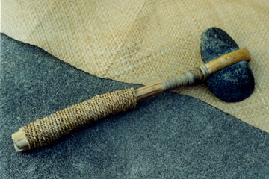
Archaic Indians
© 2014 Brain Wrinkles

Slide 16
Archaic Indians
The Archaic Indians were hunters, gatherers, and fishermen.
They hunted smaller animals like deer and rabbits.
They also ate nuts and shellfish.
© 2014 Brain Wrinkles

Slide 17
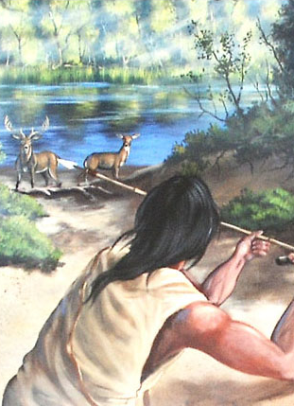
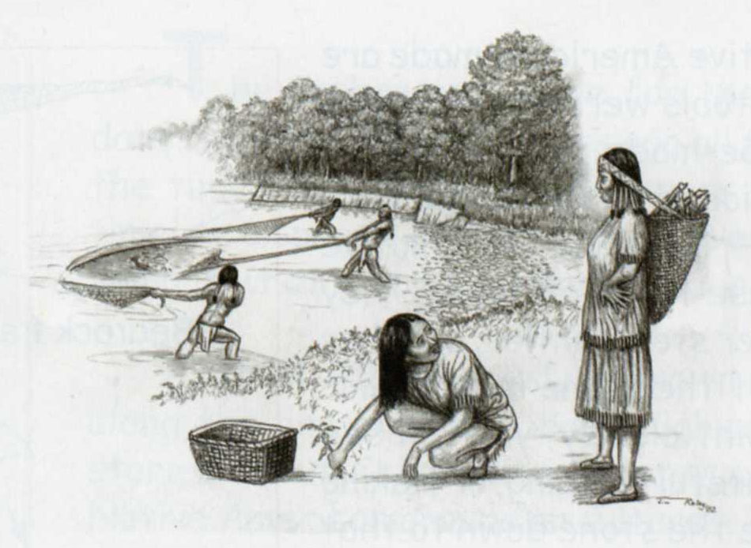
Archaic Indians
© 2014 Brain Wrinkles

Slide 18
SS8H1a
Woodland
© 2014 Brain Wrinkles

Slide 19
Woodland Indians
The Woodland Indians lived in Georgia from about 1000 BC to 1000 AD.
Their lifestyle differed from previous groups because they began to plant seeds for growing crops and they created decorative, long-lasting pottery.
They also developed bows and arrows for hunting.
© 2014 Brain Wrinkles

Slide 20
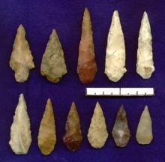
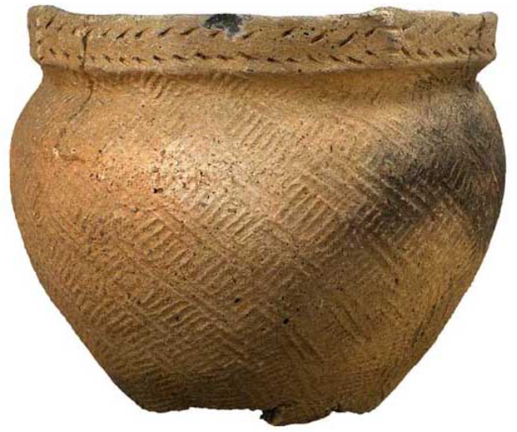
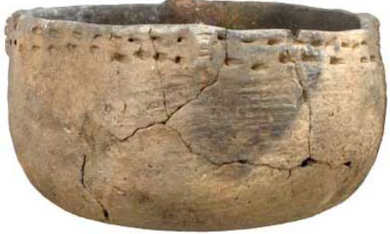
Woodland Indians
© 2014 Brain Wrinkles

Slide 21
Woodland Indians
The Woodland Indians formed tribes, created permanent villages, and lived in dome-shaped huts.
The Woodland Indians left the first evidence of religious beliefs.
They built mounds of earth for burial sites and religious ceremonies.
These were signs that the Woodland Indians believed in an afterlife.
© 2014 Brain Wrinkles

Slide 22
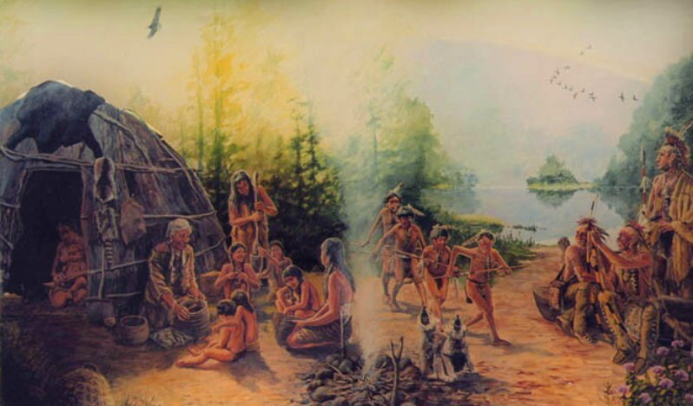
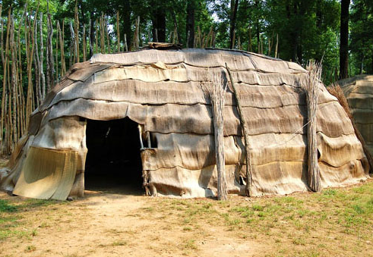
Woodland Indians
© 2014 Brain Wrinkles

Slide 23
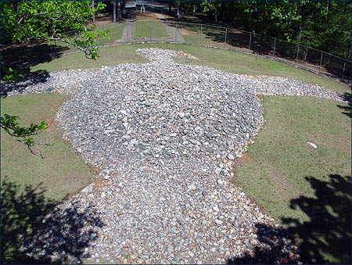
Rock Eagle is an Indian-made rock structure dating back to the Middle Woodland period (300 B.C. to A.D. 600).
© 2014 Brain Wrinkles

Slide 24
SS8H1a
Mississippian
© 2014 Brain Wrinkles

Slide 25
Mississippian Indians
The Mississippian Indians inhabited Georgia from about 800 to 1600 AD.
They lived in towns governed by chiefs, who lived in religious centers on top of large earthen mounds.
Mississippian settlements contained thousands of families.
Villages were protected by guard towers and moats.
© 2014 Brain Wrinkles

Slide 26
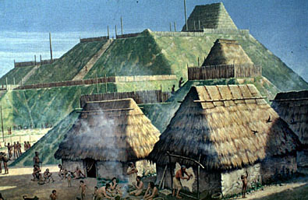
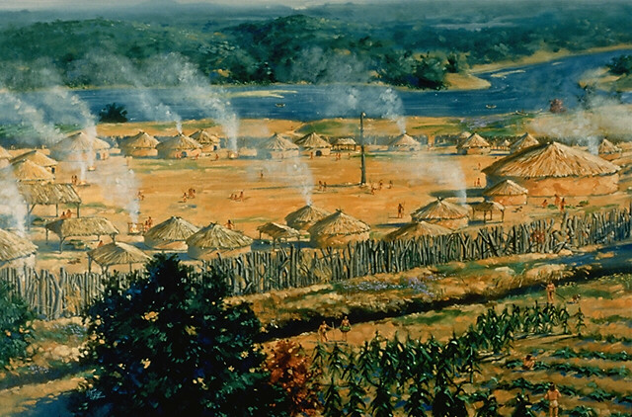
© 2014 Brain Wrinkles

Slide 27
Mississippian Indians
The Mississippian Indians used stone, wood, and bone to create weapons and farming tools.
They were accomplished craftsmen, creating pottery, pipes, instruments, and jewelry.
The Mississippian Indian groups traded tools, weapons, pottery, and other goods with one another.
© 2014 Brain Wrinkles

Slide 28
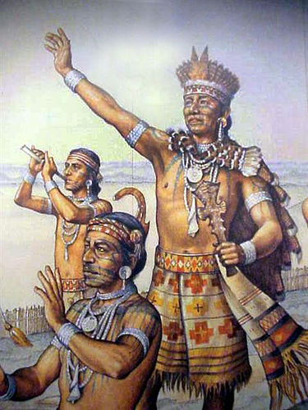
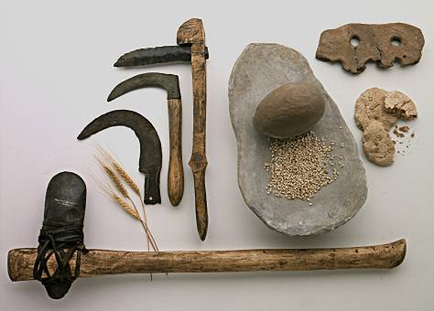
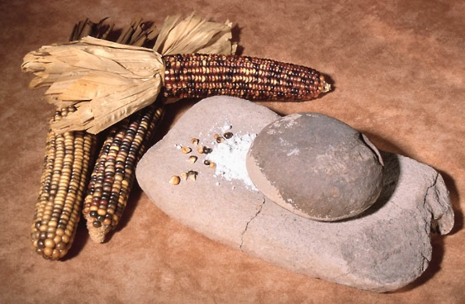
© 2014 Brain Wrinkles

Slide 29
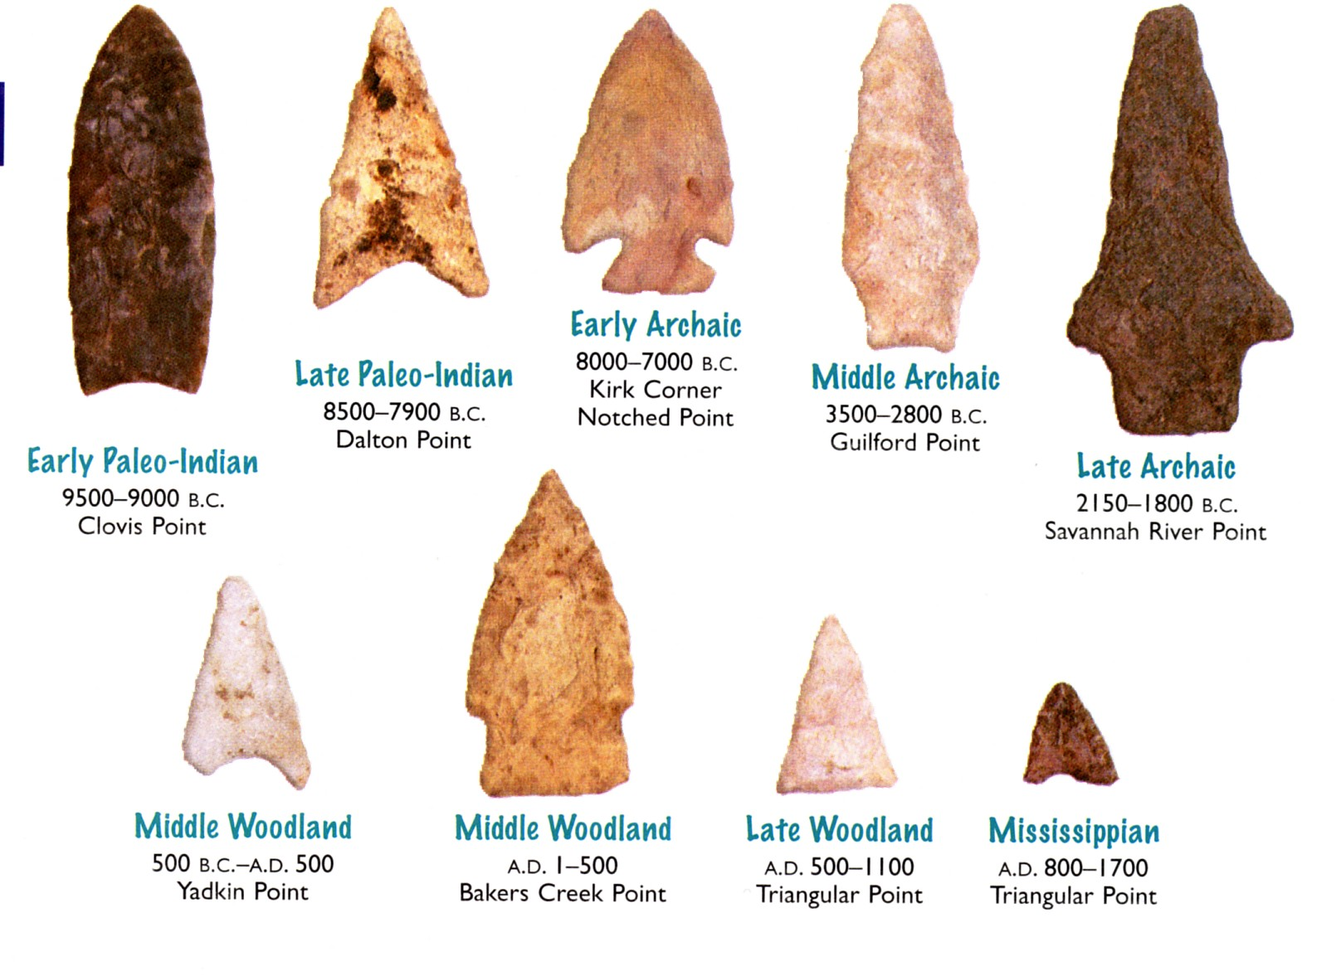
© 2014 Brain Wrinkles

Slide 30
Mississippian Indians
Mississippian Indians began farming on a large scale—they grew maize, squash, beans, tobacco, etc.
They built flat-topped burial mounds and had religious ceremonies.
The dead were buried in fine cloths with feathered headdresses and the bodies were tattooed and painted.
© 2014 Brain Wrinkles

Slide 31
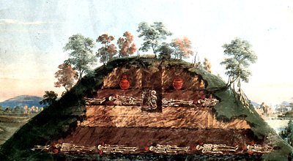
© 2014 Brain Wrinkles

Slide 32
Mississippian Indians
They were alive when Europeans discovered America, but soon after their culture began to disappear…
© 2014 Brain Wrinkles

Slide 33
Native American Cultures - KEY
Directions: Complete the chart below while discussing the presentation.
 | Dates | Dwelling | Food | Tools | Interesting Facts
Paleo | 10000 to 8000 BC | Nomadic; nonpermanent dwellings | Large animals, berries, nuts | Stone tools (spearheads) | Answers may vary. -Paleo means ancient in Greek. -Lived in groups of 25-30. -Covered shelters with animal hides and bark.
Archaic | 8000 to 1000 BC | 1st permanent settlements but moved seasonally in search of food | Smaller game (deer, rabbits), fish, nuts | Tools and weapons out of stone and bone | Answers may vary. -Were hunters, gatherers, and fishermen
Woodland | 1000 BC to 1000 AD | Tribes lived in permanent villages in dome shaped huts | Used seeds to plant crops | Developed bows and arrows | Answers may vary. -Created decorative, long-lasting pottery -Left the first evidence of religious beliefs
Mississippian | 800 to 1600 AD | Large towns governed by chiefs | Began farming on a large scale—maize, squash, beans, tobacco, etc. | Used stone, wood, and bones to create weapons and farming tools | Answers may vary. -Settlements contained thousands of families -Villages were protected by guard towers and moats -Built flat-topped burial mounds -Alive when Europeans came;
© 2014 Brain Wrinkles

